Slide 1
Analysis of Customer Service Data
Nile (by iVision)
Prepared by
Pratik Datta
ABADS Batch 8A

Slide 2
Customer Sentiment Analysis
The frequency of Negative Sentiment is quite high which is definitely an area of concern and needs to be dealt with utmost priority. The customers are needed to be reached out personally and the reason has to be identified for their negative sentiments. It is very alarming for the customer churn issue.
Also, The frequency of neutral comment is high which can be addressed and converted into positive sentiments. So many customers are not giving any feedback which is leading to the high number of neutral feedback. There might be possibility of presence of happy customers in this particular group of people who have ignore to give feedback

Slide 3
Response Time Analysis
Most of the responses are within SLA or below SLA which is a good sign, Indicating good overall response time by the support team. This indicates that the service team is following a good turn around time (TAT) for resolving the customer queries in time, which ultimately leads to the customer satisfaction for the overall client base
The Small number of Above SLA cases need to be addressed. As, slowly the number from above SLA might get transferred to the below SLA or even within SLA categories with even more strategic planning to see into the reason for delayed response

Slide 4
Root Cause Analysis
Most prevalent Query that comes in is the Billing Question. As understandable, billing is the most critical matter in every organization and has to be dealt with utmost priority. The customers may get churned if the issues are too prevalent and recurring in nature. May be classifying the billing issues to even more sub classes might help to resolve the same more efficiently in the future
The Billing Department needs to take note of it in order to reduce the number of billing Queries in future. Even the number rises with more customer acquisition the department has to be on their toes.

Slide 5
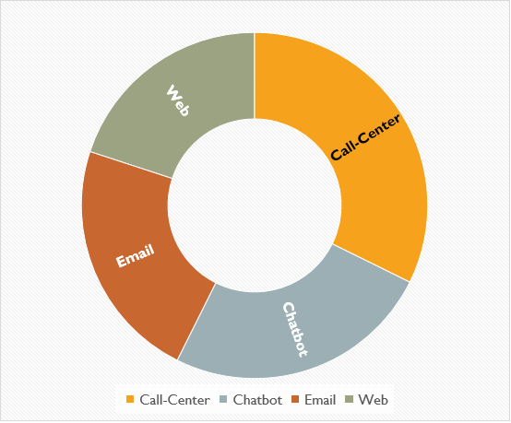
Preferred Channel Analysis
Call Center is the most preferred Channel by the customers. As we can understand that call is the most convenient way one can connect to the support team for their respective concerns. It is also important to have adequate manpower to attend that amount of calls so that the waiting time for the customers in calls do not increase which again will lead to the customer dissatisfaction only
All the channels are more or less equally preferred by the customers which is a good sign. But still it’s a challenge to keep the balance and also divert customers from one channel which is very busy to other channels which may serve them even better

Slide 6
Call Duration Analysis
The Graph show the average call duration for the different Call Centers and Different Channels. It show a picture of the time taken by different call centers with respect to different communication channels preferred by the customers. It is a good tool specifically for the monitoring department to keep a track of the different call centers and for any measures that can be taken as per the requirement
The Email Channel for Chicago Call center has the highest Average Call Duration and for the same call center Web Channel has the lowest Call Duration. There is not a direct impact but indirectly it has some indication for the managerial decision making.

Slide 7
CSAT Score Analysis
The Graph show the average CSAT Score for the different Call Centers and Different Channels. Again it is a very important metric which is directly related to the Customer satisfaction score varying with combination of different communication channels and different call centers located at different geographical locations. Some demographic insights might come up for any upcoming strategies
For Denver Call centre and Web Channel the CSAT Score is highest and Email channel for Chicago Call Centre has the Lowest Average CSAT Score. These extreme points might be needed to address any underlying issues or advantages for respective point

Slide 8
CSAT Score over time
The Line graph shows the Timeline Story of Average CSAT Score for the Company across all the channels and Call Centers. Here the overall growth or decline can be observed by the monitoring department regarding the performance and quality of the voice teams as well as the technical and delivery teams. Generally a steady incline is wished
The overall picture shows a good growth considering the numbers from January and December data. However, there have been certain declines in between which is definitely need to be addressed to see any seasonality or other reasons

Slide 9
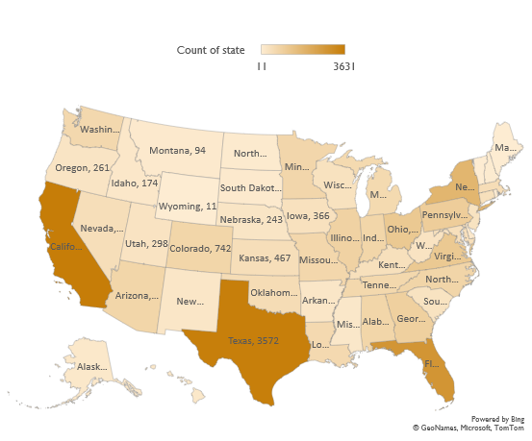
Demographics
The Map shows the demographic information of the clients residing in different parts of the country. It is a good tool to have to see the ongoing demographic development in the country.
Although, the count may not be a very good indicator but in today’s competition driven economy and business, churn is one of the main concerns for all the organizations competing in this dynamic business environment.
Based on the data available we can see that most of the customers belong to the California, Texas & Florida States. As the climate plays a part in a country as widespread like USA, the customer count is low in states located north of the country.

Slide 10
Thank You

